Slide 1
Mashery Workshop
Part 1
Mark Mussett
mmussett@tibco.com
July 2020

Slide 2
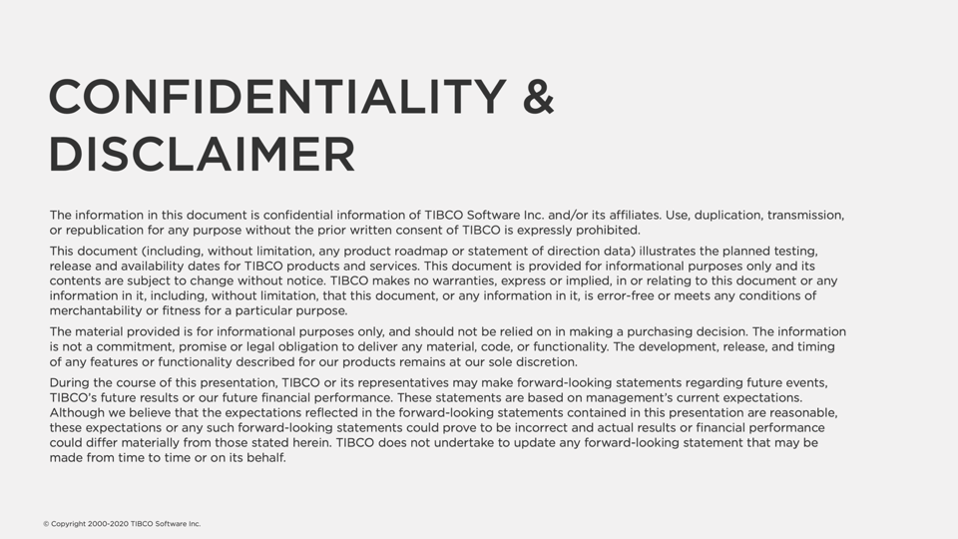

Slide 3
Agenda
Overview of TIBCO Cloud API Capability
Architecture
Mashery Control Centre
API Definition
API Products with Mashery Package & Plans
API Consumer
Test APIs with Postman
Analytics

Slide 4
Overview of TIBCO Cloud API Capability

Slide 5



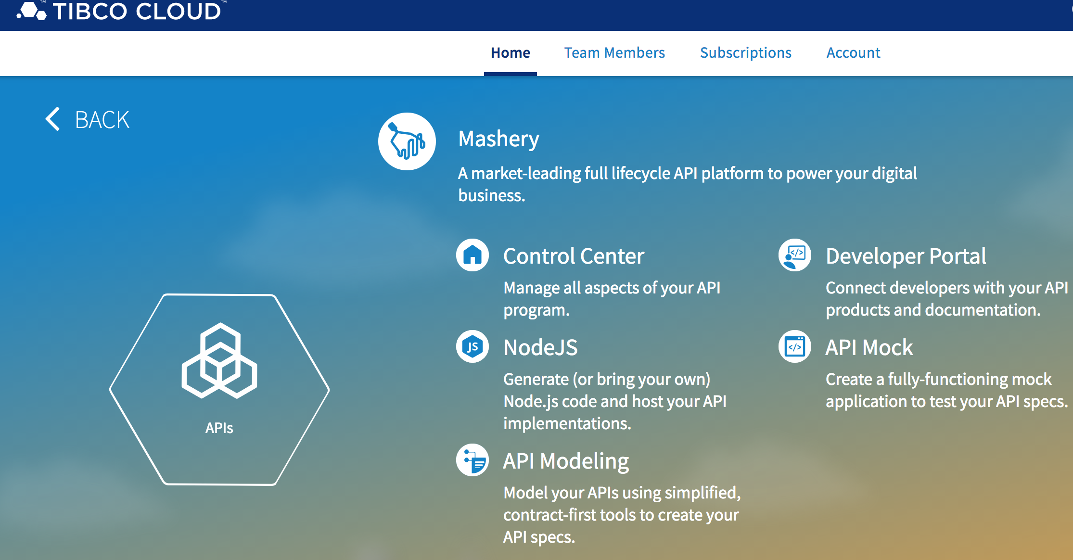







TIBCO Cloud™ Mashery®
The cloud-native API platform you can deploy anywhere, and manage APIs from everywhere
CREATE your APIs from any data source
PRODUCTIZE private, partner, and public APIs
SECURE your APIs with authentication and access
ANALYZE performance of your program in real-time
Notes:
This is precisely how we’ve designed our API platform, TIBCO Cloud Mashery

Slide 6

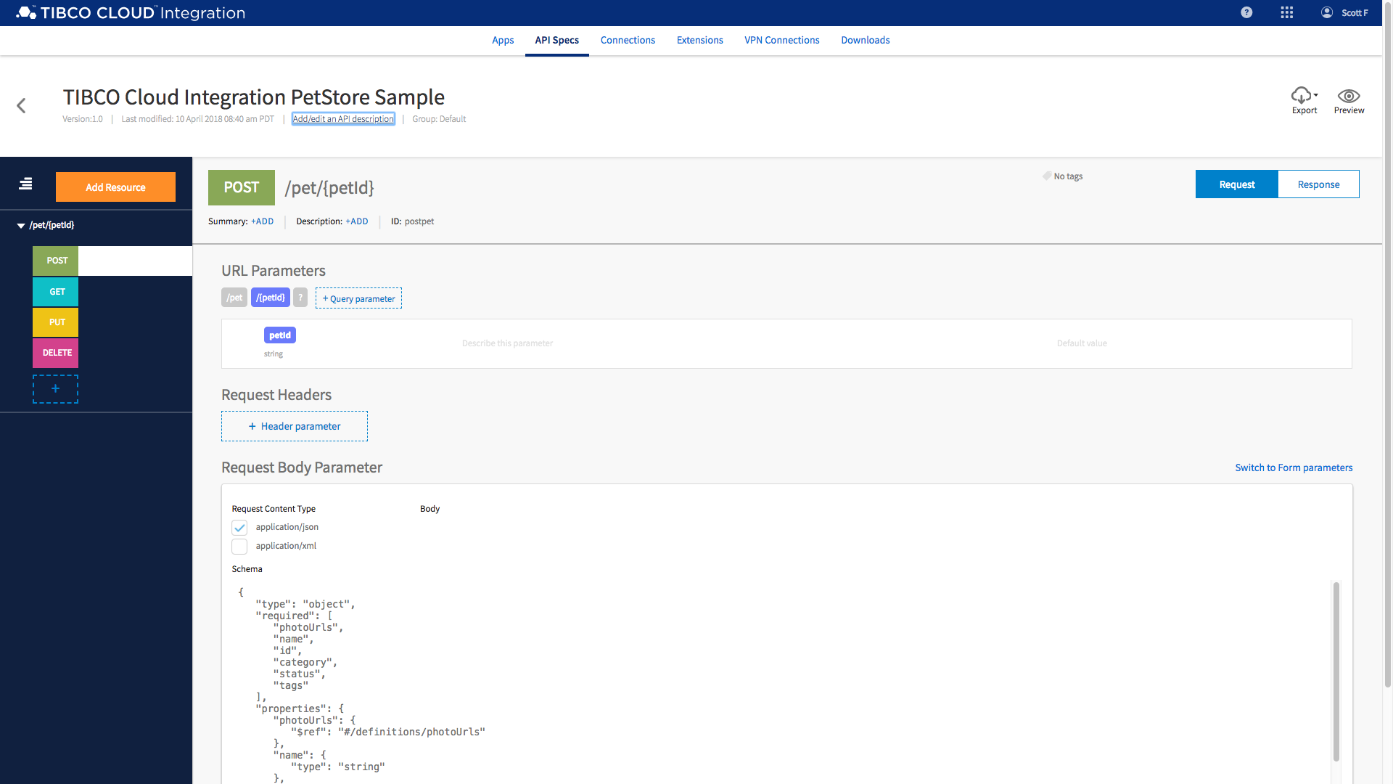
Create
Easily access your key services and data to create your APIs
Key Capabilities
Model any data source and utilize contract-first modeling, with native OAS, plus native Node.js hosting of API implementations
Architect your cloud-native apps with API choreography, event-driven APIs, and other non-REST protocols
Standardize API testing with CI/CD automated tests for load, headers, objects, data, and business logic

Slide 7



Productize
Define API product packages and take them to market
Key Capabilities
Package, catalog, and discover API products, including API-led microservices within Kubernetes
Engage developer audiences using a developer portal and customized workflows with your look and feel
List your API products on AWS Marketplace for seamless billing and consumption

Slide 8

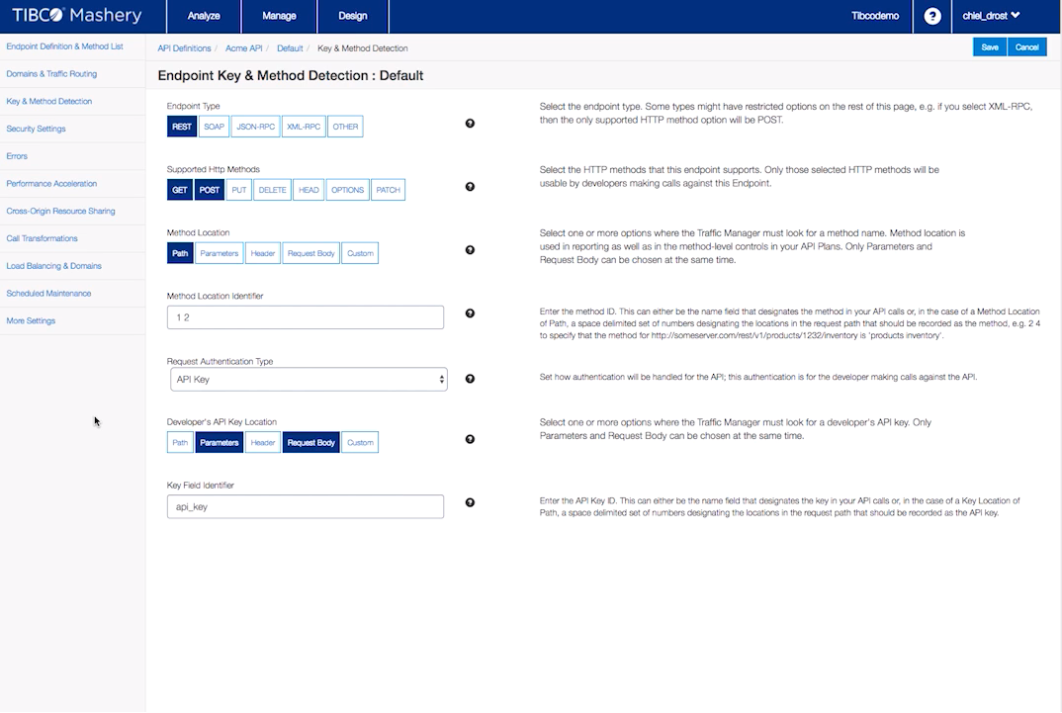





Secure
Robust authentication and authorization to manage API access and traffic
Key Capabilities
Single system management of traffic for all gateways, including embedded microgateways
Define access & security policies like rate limiting and throttling between different consumers
Robust security standards such as OAuth2, HTTPS, JWT, HMAC, XML sig, Kerberos, CORS, WS-I, ISO 27001

Slide 9

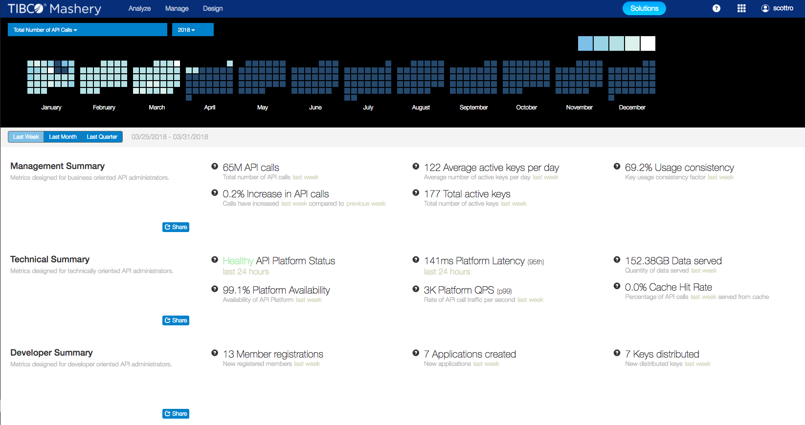
Analyze
Scale and optimize with market-leading analytical insights
Key Capabilities
Ensure API program performance across globally distributed regions with optimized token sync, auto-scaling, and response caching
Monitor and visualize custom operational and usage-based KPIs with endpoint-level drilldown
Analyze your APIs within Mashery or export batch or streaming data for advanced analytics with tools like TIBCO® Spotfire

Slide 10












The cloud-native API platform you can deploy anywhere
As a Service
Hosted and Managed by TIBCO
On-Premise
Full control, fully cloud-native
On Private Cloud
Full control, fully cloud-native
On Public Cloud
Hosted by cloud vendor
Any CaaS
Any IaaS
AWS Marketplace

Slide 11




Manage APIs from Everywhere with cloud-native, federated architecture
Public Cloud
IoT & Edge
Private Cloud
IoT & Edge
IoT & Edge
Database
On-Premise

Slide 12





TIBCO Cloud Mashery Microgateway
Cloud-native gateway framework that complements service meshes
Powered by open source Project Flogo®
An event-driven microgateway designed for cloud-native microservices
Ideal security proxy for distributed microservices ecosystems
Event-driven design with 1st-class support for AWS Lambda
Ultralight footprint that can be embedded in edge devices or deployed as a federated microgateway

Slide 13
Architecture

Slide 14
TCI
Mashery API Distribution
API Modeller
Registration
API Definition
Log Management
API Mock
Static Documentation
API Doc Configuration
OAuth
Publication To Mashery
API Testing
API Packaging
Reporting / Analytics
Apps
Blogs / Forums
Data Filters
Organisations
Support
Service Creation
Dev Portal Configuration
Platform APIs
Local Traffic Manager

Slide 15
















Mashery
API Management
DEVELOPERS
BUSINESS ASSETS
Developers
SAML 2.0
Corporate
IdP
Standard APIs
Developer Portal
Partners
Open Devs
Mashery AAA
Traffic Manager
Customers
Employees
Control Center
Analytics
Cache
Client Applications
App Servers
ESB
XML Gateways
Various Devices and Apps
TIBCO Cloud
TIBCO Cloud or Local
Disparate Data Sources
Admin
Multiple Data Centers
Integrations & Websites

Slide 16
Mashery Control Centre

Slide 17
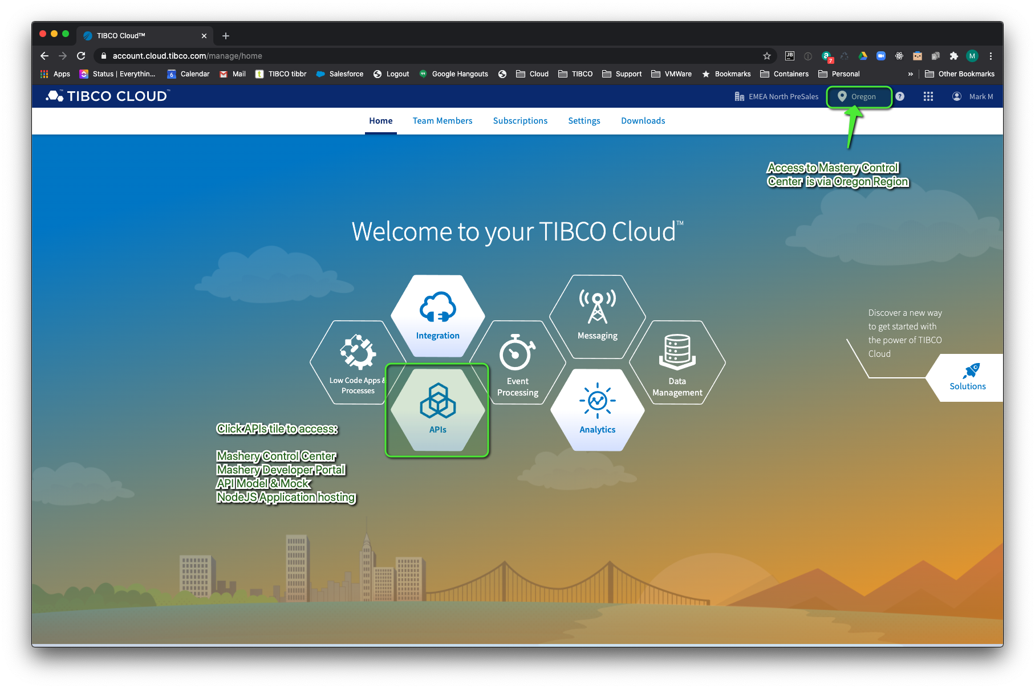

Slide 18
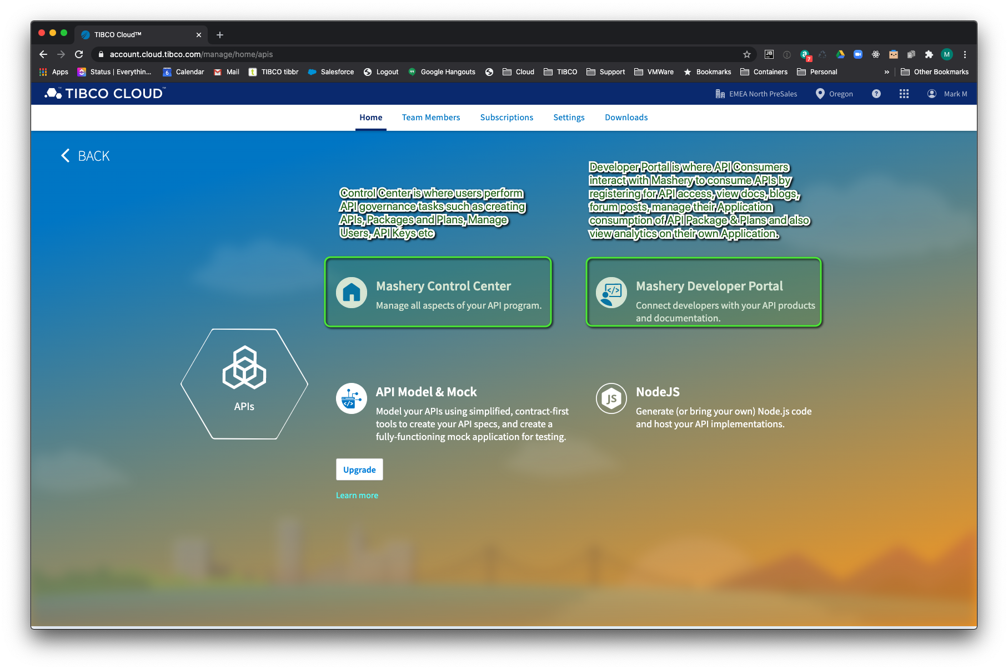

Slide 19
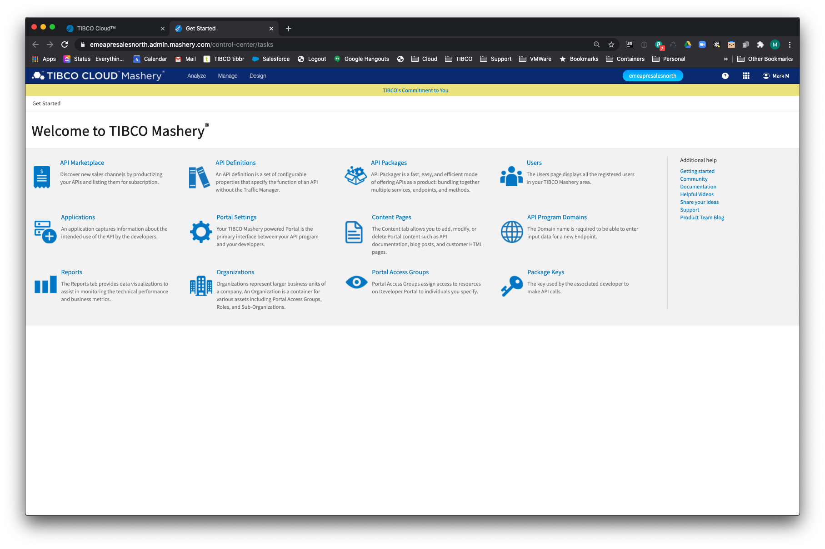

Slide 20
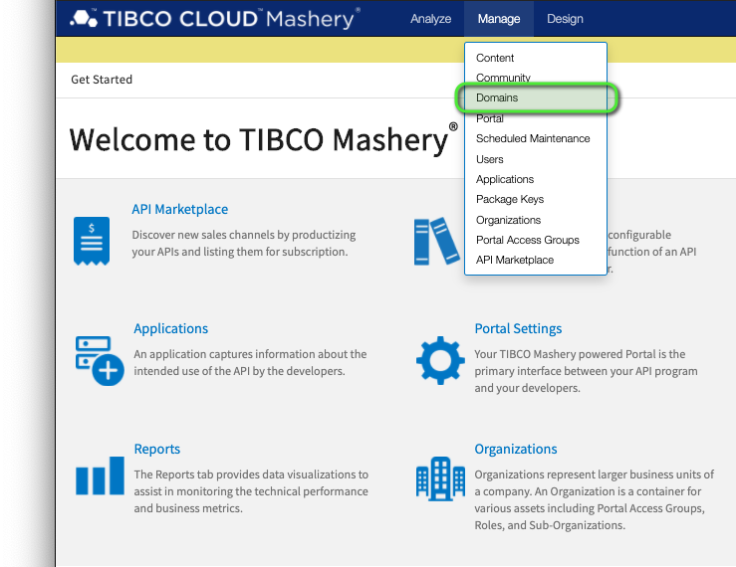
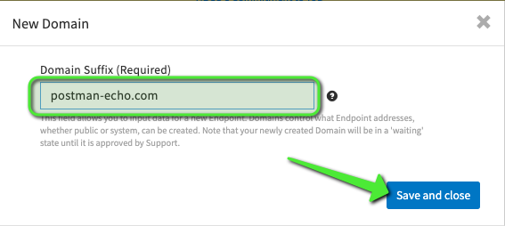
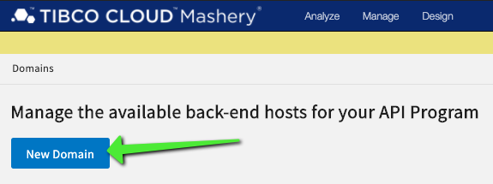
Proxying an outbound API through Mashery
In order for Mashery to allow you to setup an API call with any external host that is acting as your back-end then we must first enable it via the Manage-> Domains menu option..

Slide 21
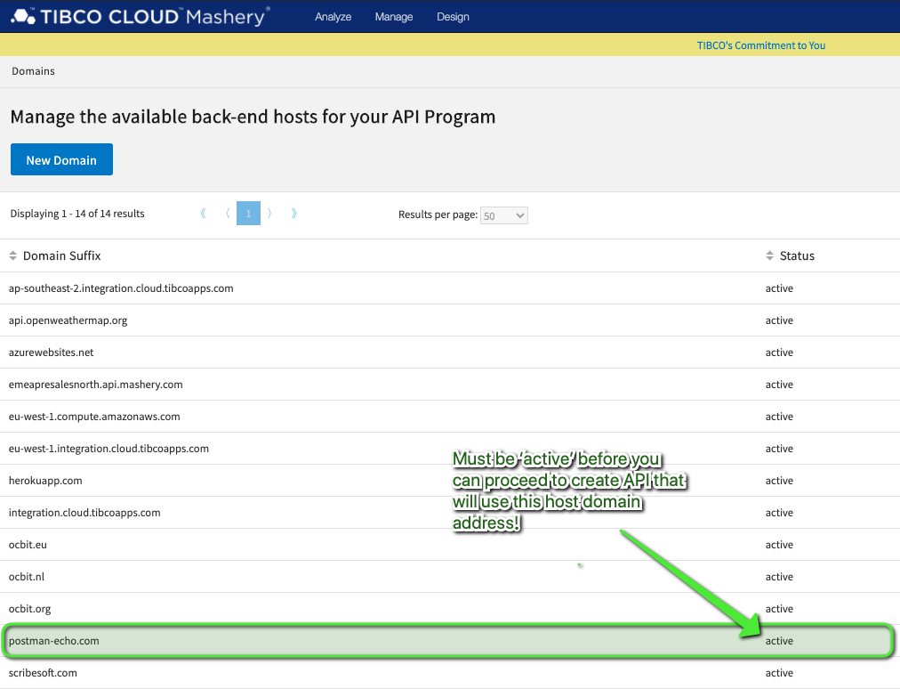
TIBCO Cloud Operations has to activate this on your behalf…

Slide 22
API Definition

Slide 23
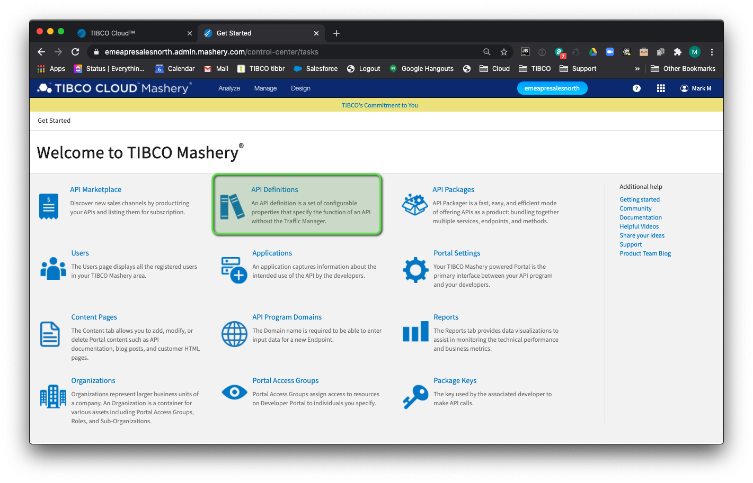
Create outbound API Definition

Slide 24
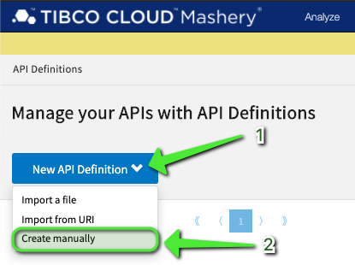
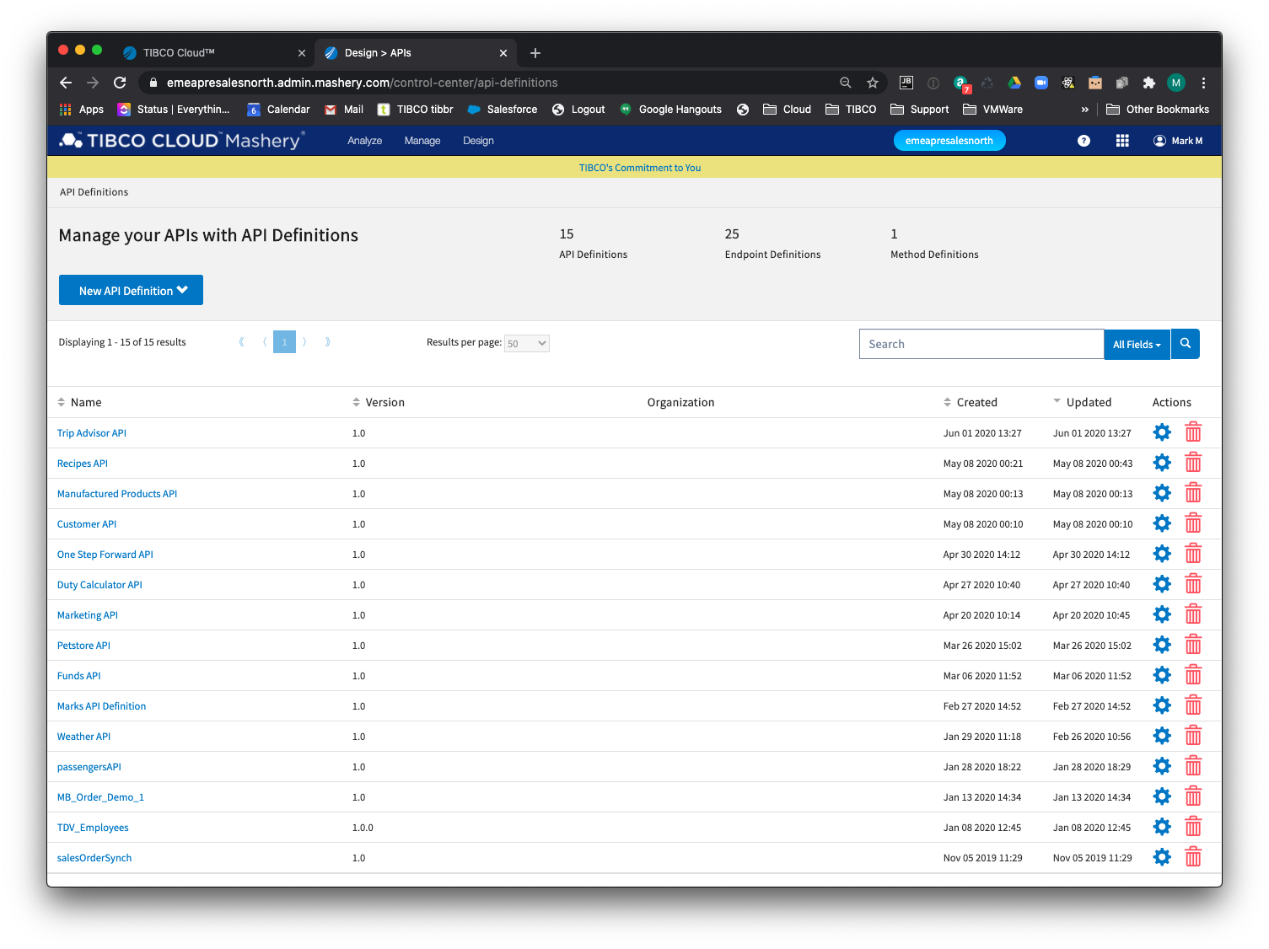
(1) Click New API Definition menu option
(2) Click ‘Create manually’

Slide 25
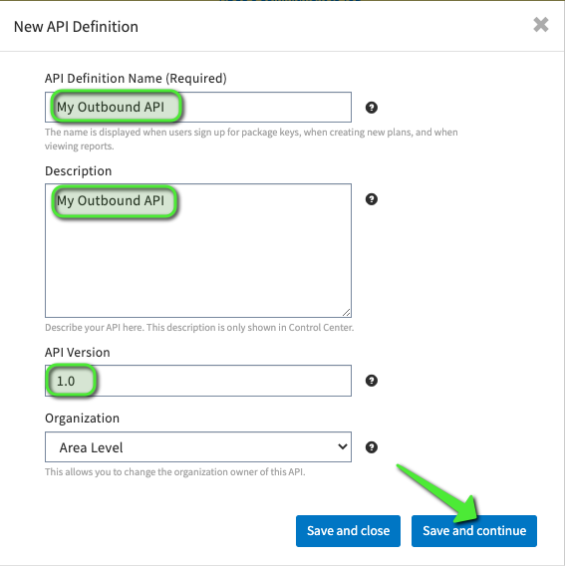
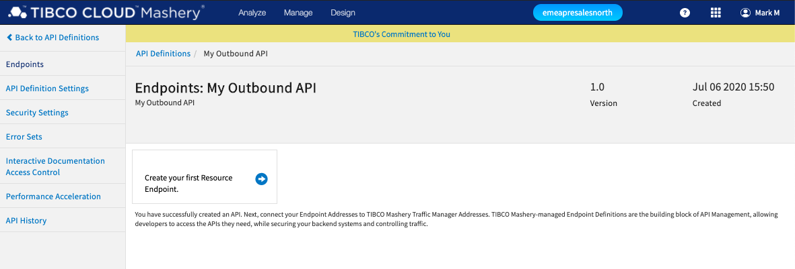

Slide 26
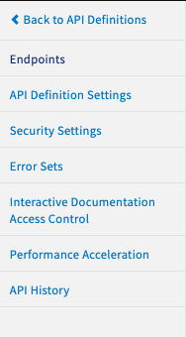
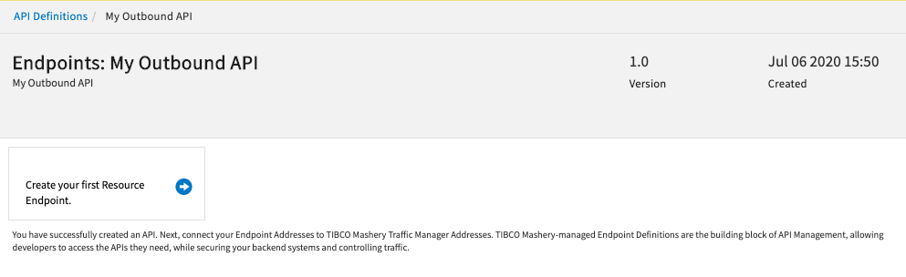
API Definition Menu
Endpoints
Create and manage any existing Endpoints for an API

Slide 27
API Definition Menu
API Definition Settings
Manage API definition:
Name
Description
Version
Overall API QPS Throttle
CORS & Robots Policy
Organisation/Group owner

Slide 28
API Definition Menu
Security Settings
Enable OAuth 2.0 for the API

Slide 29
API Definition Menu
Error Sets
Allows you to customise the HTTP Status message, HTTP Header and Response Body for any 4xx or 5xx HTTP Response Code

Slide 30
API Definition Menu
Interactive Documentation Access Control
Controls which Mashery Role will have access to the Interactive Docs in the portal.
Roles can be added via the Manage->Portal Access Groups menu option.
https://support.tibco.com/s/article/Mashery-Roles
Set to ‘Everyone’ to allow public access.
Set to ‘Member’ to allow only authenticated users access.

Slide 31
API Definition Menu
Performance Acceleration
HTTP Cache control setting to set TTL cache period for responses.
Not enabled by default.

Slide 32
API Definition Menu
API History
Change history for API. Allows you to compare versions and revert changes.

Slide 33
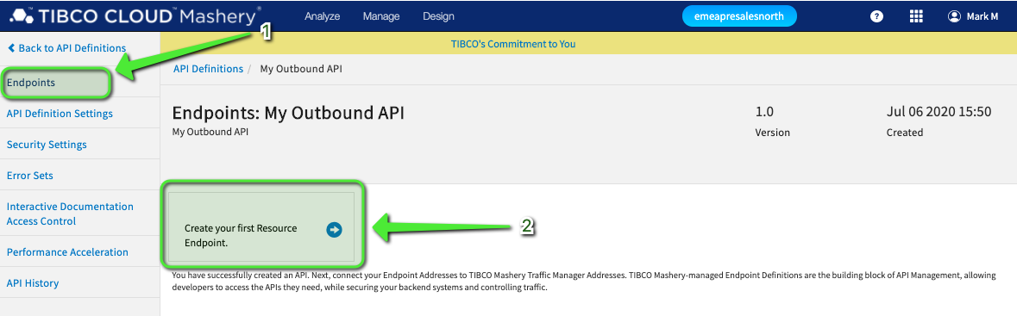
Create Endpoints on API Definition

Slide 34
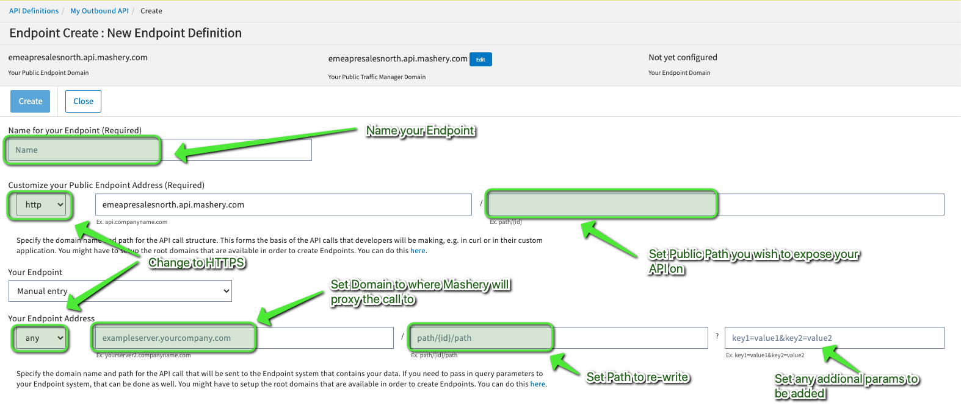
New Endpoint Definition

Slide 35
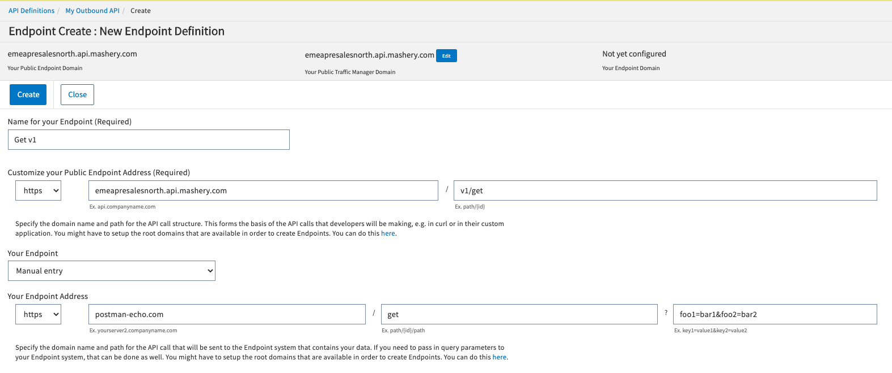

Slide 36
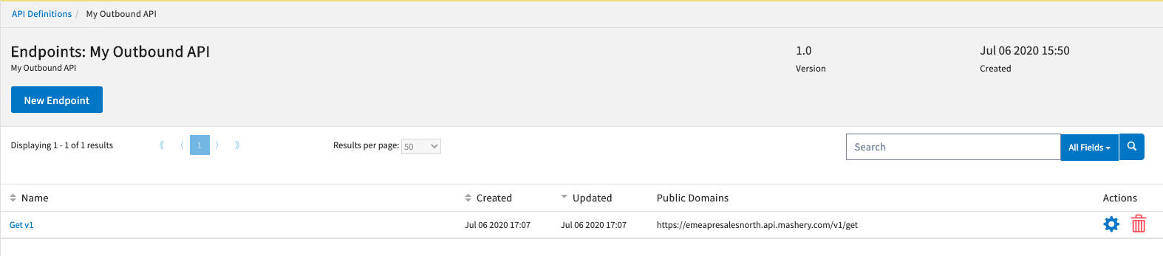
API call to https://emeapresalesnorth.api.mashery.com/v1/get will be proxied to https://postman-echo.com/get

Slide 37
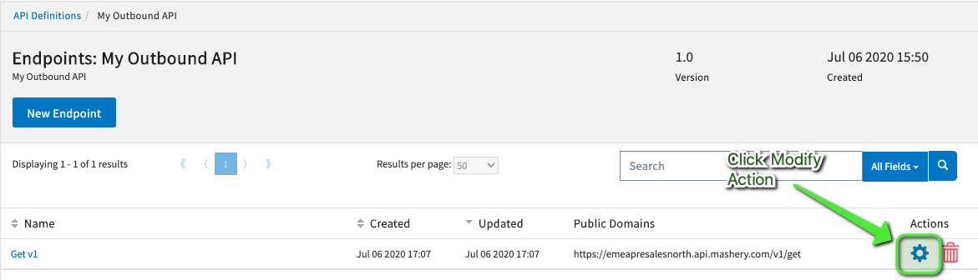
Modify Endpoint

Slide 38
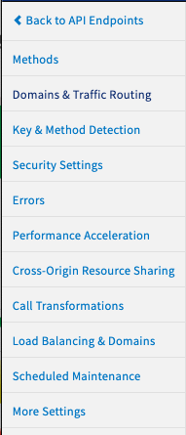
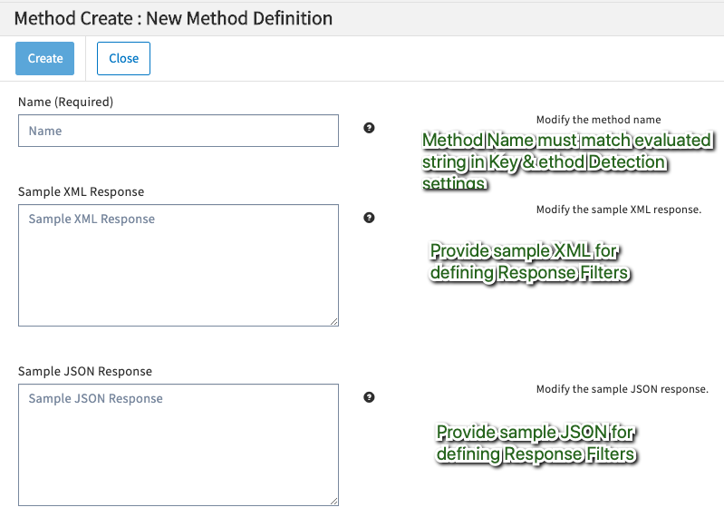
API Endpoint Menu
Methods
Allows you to set fine-grained control based on identifiable values within the path.

Slide 39
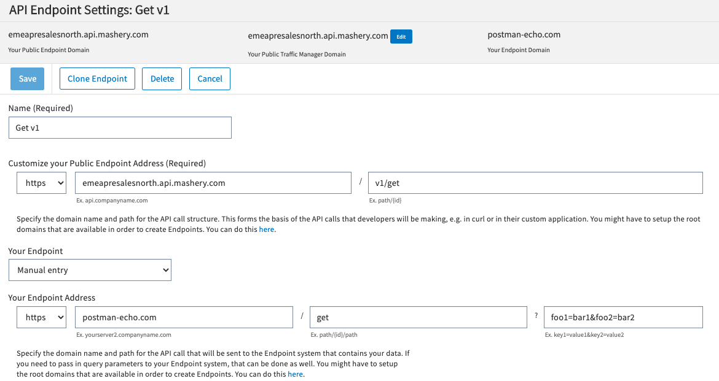
API Endpoint Menu
Domains & Traffic Routing
Define Public Address and Back-end Address.

Slide 40
API Endpoint Menu
Key & Method Detection
Sets governance characteristics on this Endpoint:
Type - REST, SOAP, JSON-RPC, XML-RPC, OTHER
Supported Http Methods - G/Po/Pu/D/H/O/Pa
Method Location & Identifier – Define where Traffic Manager looks to find Method name
Request Auth Type – API Key, Hash, OAuth2, Custom
API Key Location – Where Traffic Manager looks to find API Key
Key Field ID – Field name or position of where to find API Key value

Slide 41
API Endpoint Menu
Security Settings
Sets the Backend Endpoint security:
Basic Authentication or Client Authentication
Username & Password
Always enable HTTPS
Mashery Traffic Manager
Basic Authentication
Backend Endpoint
Client Certificate
Customer Certificate
Backend
Certificate

Slide 42
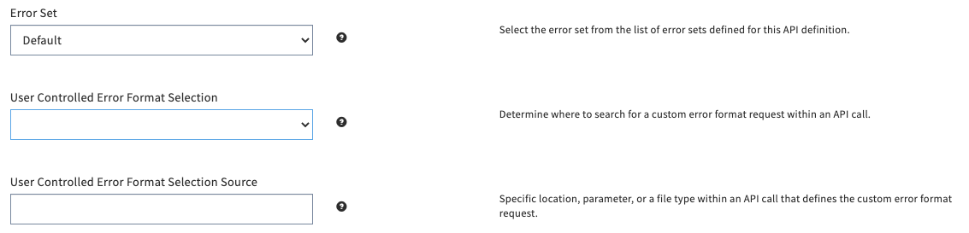
API Endpoint Menu
Errors
Sets the Error Set you wish to use

Slide 43
API Endpoint Menu
Performance Acceleration
Tunes HTTP Response Cache settings

Slide 44
API Endpoint Menu
Cross-Origin Resource Sharing (CORS)
Settings for CORS

Slide 45
API Endpoint Menu
Call Transformation
Enables Mashery Connectors to process Authentication, Ingress and Egress flow pipeline.

Slide 46
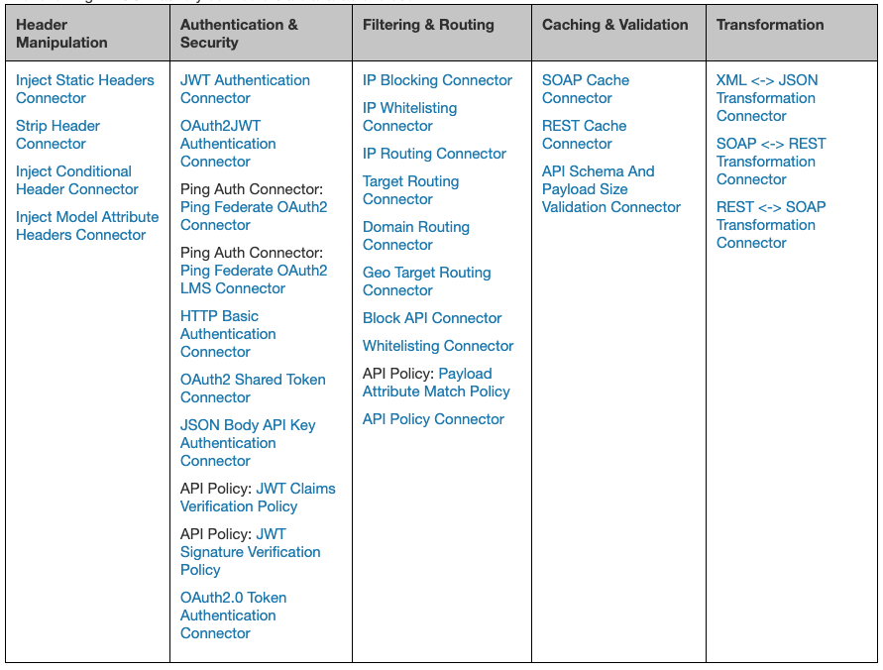
https://docs.mashery.com/connectorsguide/index.html

Slide 47
API Endpoint Menu
Load Balancing & Domains
Allows you to set multiple public endpoint address your Endpoint is addressable with, and also multiple backend addresses.
Public endpoint – allows same API endpoint to be hosted on multiple domain names
Backend endpoint – Mashery will round-robin load balance call across multiple endpoints

Slide 48
API Endpoint Menu
Scheduled Maintenance
Sets Start Time and End Time for any planned maintenance on the API.
When enabled clients will receive a 503 Service Unavailable response from Mashery

Slide 49
API Endpoint Menu
More Settings
Various settings on Endpoint:
Timeouts (Egress)
Redirects
Cookies
GZIP
Disable API Key
API Key Swapping
Stripping API Key & Signature Query Params
Drop Host Header
Drop Http Headers
Forwarded and Returned Headers
Return Rate Limit information

Slide 50
Configure your API Endpoint
Modify the Get v1 Endpoint:
Key & Method Detection
Set Endpoint Type to REST
Set Supported Http Methods to GET
Set Developer’s API Key Location to Header
More Settings
Enable all Forwarded Headers & Return Headers
Enable Rate Limit Information

Slide 51
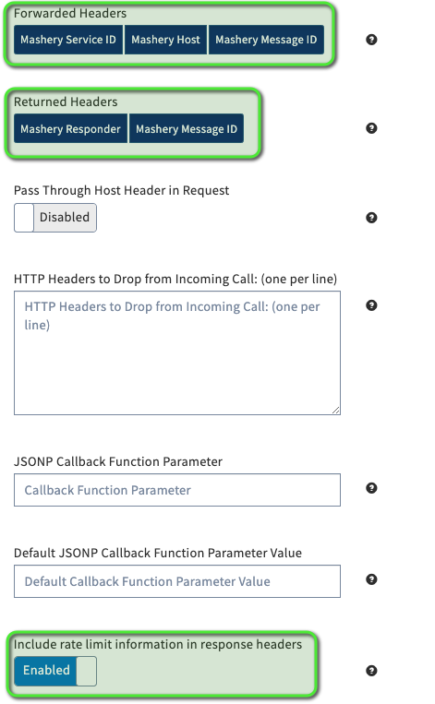

Slide 52
API Products with Mashery Package & Plans

Slide 53
API Definition
API Packaging
API
Endpoint
Method
Package
Plan
API Usage
Developer
Application
API Key
API
0 - N
Endpoint
0 - N
Method
1 - 1
Package
0 - N
Plan
1 - 1
Developer
0 - N
Application
0 - N
API Key

Slide 54
Package & Plans
API Definitions are not consumable in Mashery until they are added to a Package and Plan.
Packages and Plans are a way of creating API Products.
API Clients (Developers) consume APIs via an Application.
The Application must be registered in Mashery.
An Application is assigned an API Key that has an “loose” association to a designated API Package & Plan.

Slide 55
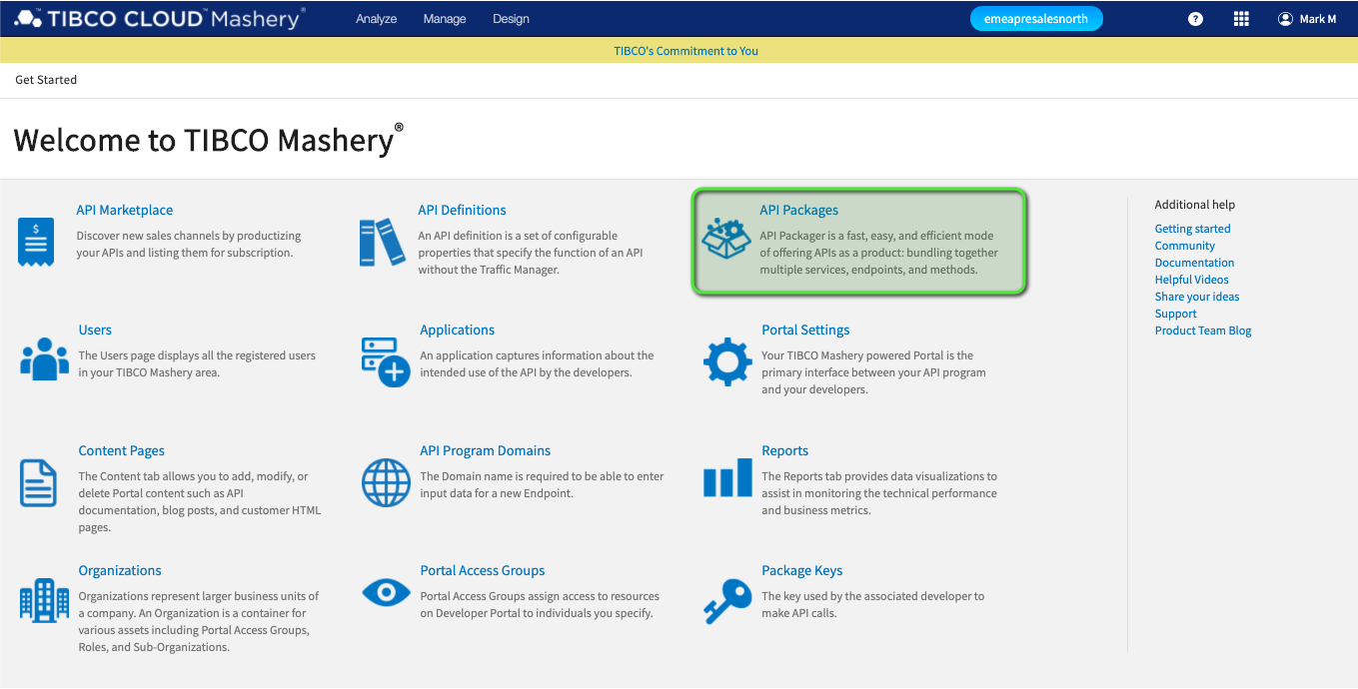
Create Package and Plans

Slide 56
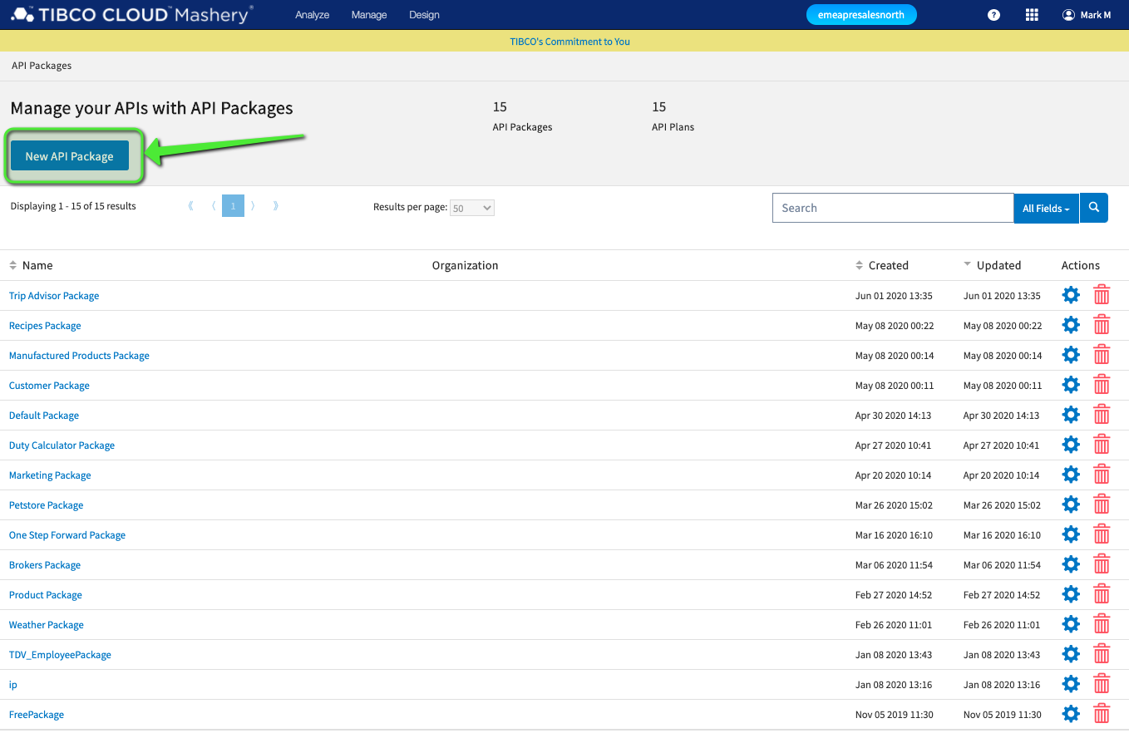
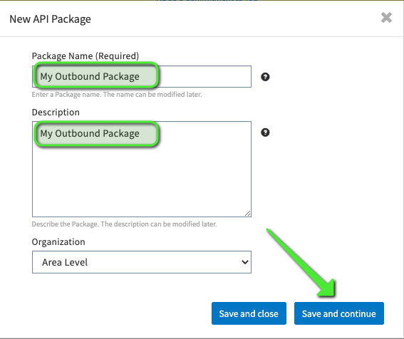
Click New API Package button

Slide 57
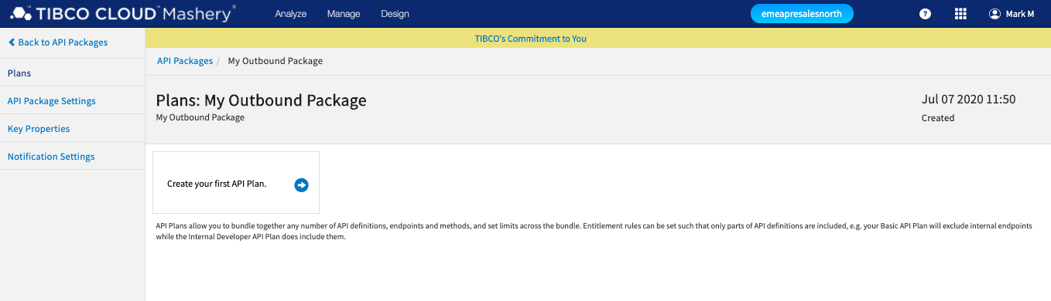

Slide 58
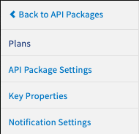
API Package Menu
Plans
Allows you to create, modify and delete API Plans under this Package

Slide 59
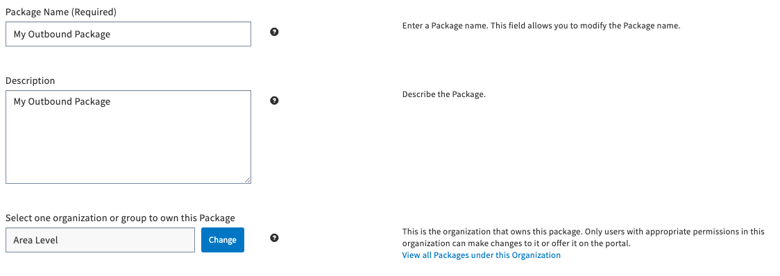
API Package Menu
API Package Settings
Modify API Package Name, Description and Organisation/Group settings

Slide 60
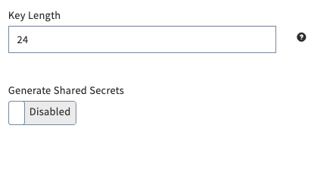
API Package Menu
Key Properties
Sets Key Length & Shared Secret

Slide 61
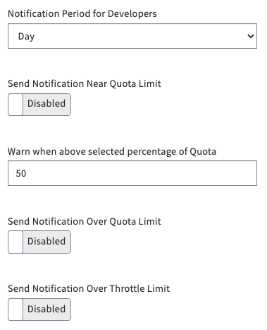
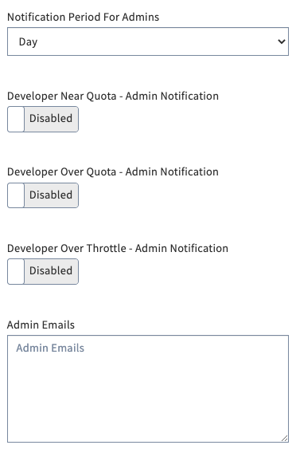
API Package Menu
Notification Settings
Sets Notification trigger points for various Quota and Throttle overages:
Over Quota & Throttle Limit
Near Quota Limit
Notification Period for Developer & Admins

Slide 62
Create API Package
Create API Package ‘My Outbound Package’
Enable Notification for Developers:
Enable Near Quota Limit
Set Percentage of Quota to 90
Enable Send Notification Over Quota and Throttle Limit

Slide 63
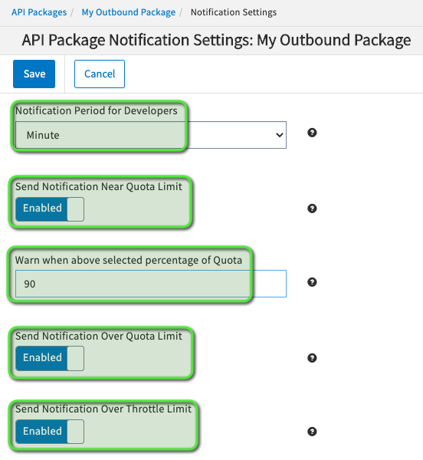
Create API Package

Slide 64
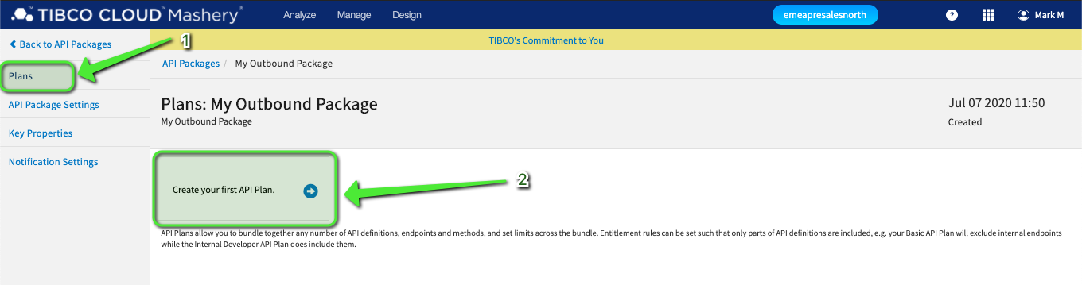
Create API Plan

Slide 65
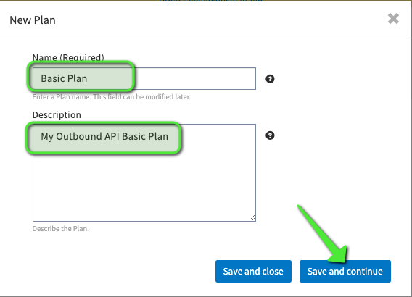
Create API Plan

Slide 66
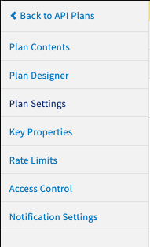
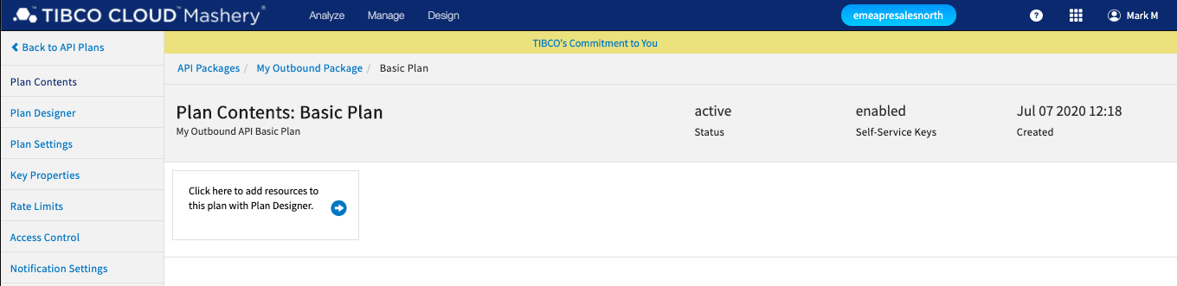
API Plan Menu
Plan Contents
Allows you to view/remove APIs within the Plan.

Slide 67
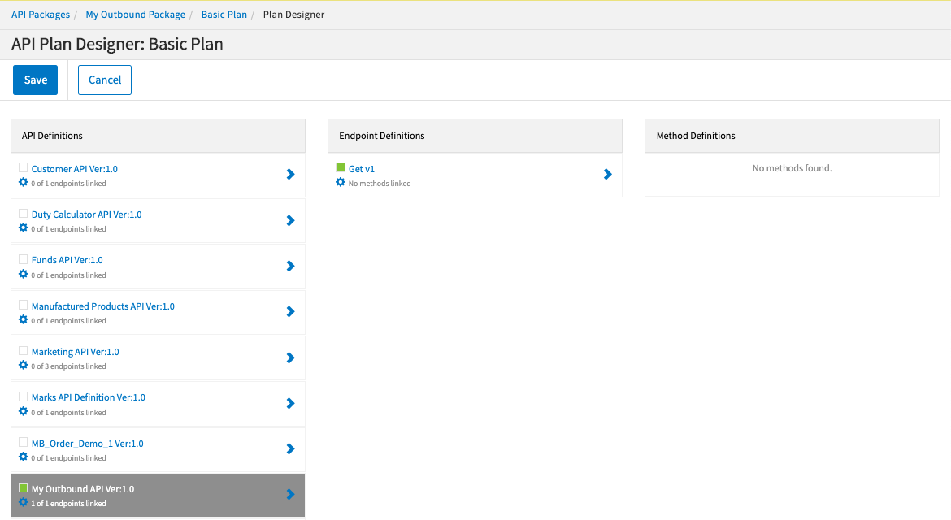
API Plan Menu
Plan Designer
Views current state of the API Plan, and…
Allows you to assign which APIs and their Endpoints and Method Definitions are contained within the Plan.

Slide 68
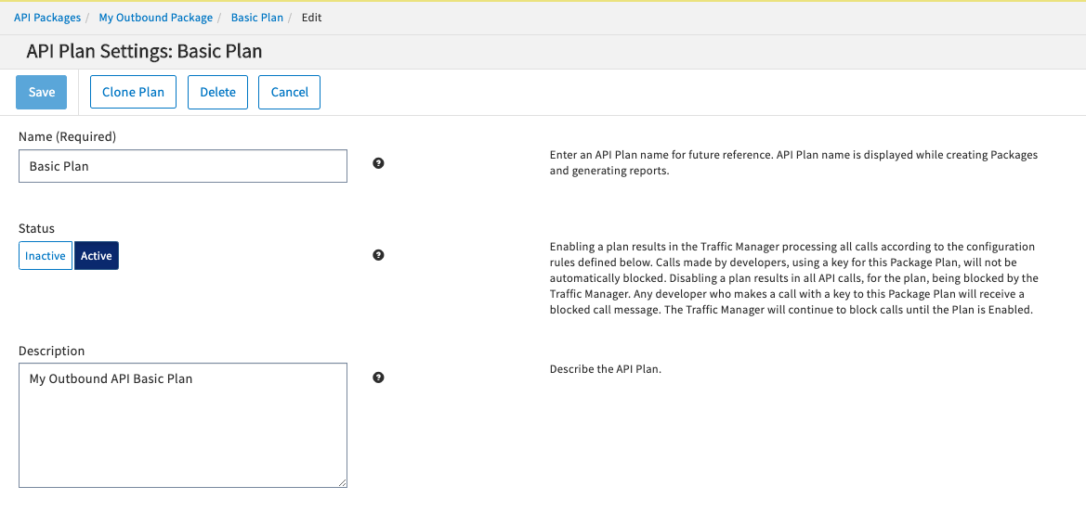
API Plan Menu
Plan Settings
Allows you to modify the Plans’ Name & Description.
Allows you to enable/disable the Plan:
API calls are blocked in the enabled state.

Slide 69
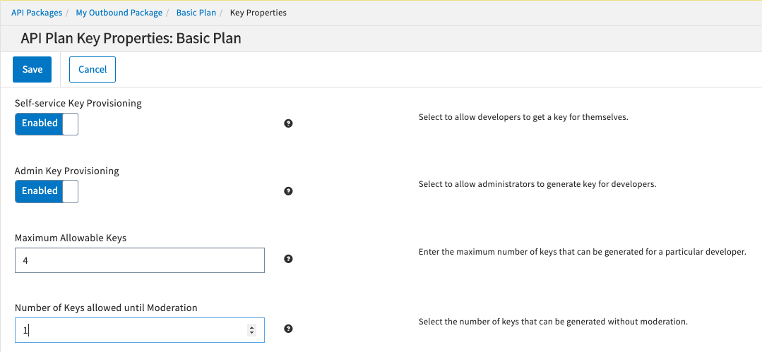
API Plan Menu
Key Properties
Allows you to control if Keys are generated through Self-service model and Administrators to generate Keys for Developers
Set number of Keys allowed per Developer & until Moderation

Slide 70
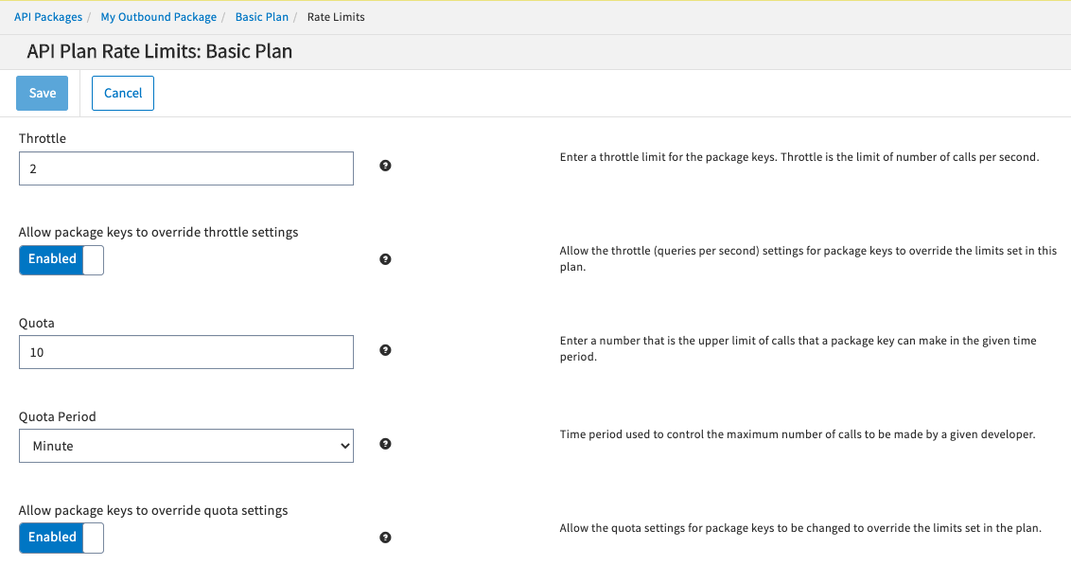
API Plan Menu
Rate Limits
Sets Rate Limits on API call traffic:
Throttle – # calls per second
Quota - # calls within a particular time period.
Notes:
These Rate Limits are applied to all API Keys associated to this Plan unless overridden for a particular API Key.

Slide 71
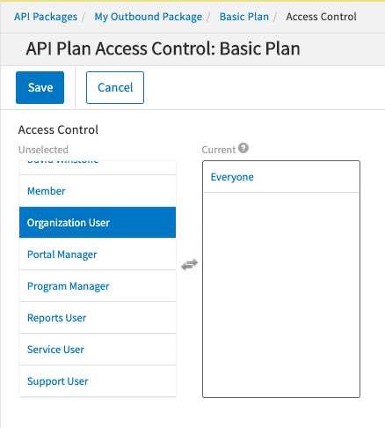
API Plan Menu
Access Control
Sets which roles can access the API Plan in the Portal
Notes:
Setting ‘Everyone’ allows any registered API Developer to request access to the API Package & Plan.

Slide 72
API Plan Menu
Notification Settings
Allows you to set the Notification Template for emails sent to Developers
Notes:
Setting ‘Everyone’ allows any registered API Developer to request access to the API Package & Plan.

Slide 73
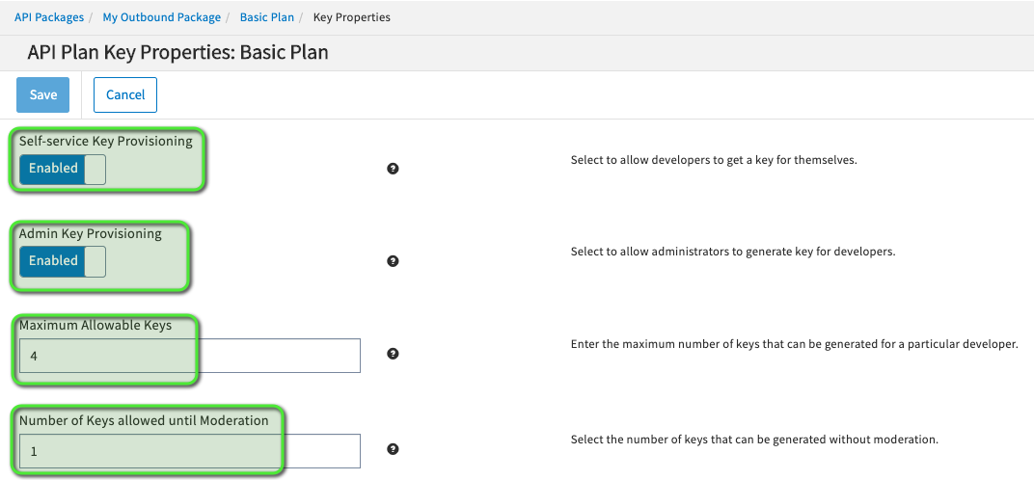

Slide 74
Create API Plan
Create Plan ‘Basic Plan’ within your Package.
Using API Plan Designer add your API.
Set Key Properties:
Enable Self-service Key Provisioning
Enable Admin Key Provisioning
Set Maximum Allowable Keys to 4
Set Number of Keys allowed until Moderation to 1
Set Access Control to allow ‘Everyone’

Slide 75
API Consumer

Slide 76
Creating API Users
Two classes of Users:
API Consumers
Control Centre Users
Users can be added via:
Manually via TIBCO Cloud
Self-Service Onboarding via TIBCO Mashery Portal
Via Mashery Platform APIs

Slide 77

Creating API Consumer via Mashery Portal

Slide 78


Slide 79


Slide 80


Slide 81


Slide 82


Slide 83


Slide 84
Create API Plan
Register a new user and sign up for your API Package and Plan.
Don’t forget to click your approval link email to enable account.
Take a note of your API Key

Slide 85
Test APIs with Postman

Slide 86



Slide 87

Test API call using Postman
Call the API using the API Key
API Key needs to be placed in to HTTP Header ‘api_key’
Keep calling the API until you hit your Rate Limits.
Throttle = 2 / Quota 10 calls/minute
Mashery will return a 403 Forbidden response

Slide 88



Slide 89
Bonus Task
Configure Mashery to block the API call.
How did you do it?

Slide 90


Bonus Answers…
Make the Package Inactive
Design->Package->Plan->Plan Settings -> Toggle Status to ‘Inactive’
Disable the API Key
Manage->Package Keys-> Toggle Key Status to ‘Disabled’
Set Maintenance Time Window on API

Slide 91
Analytics

Slide 92

Executive Summary

Slide 93


